Slide 1
Objectives
  Create a SAS data set using another SAS data set
  as input.
  Create SAS variables.
  Use operators and SAS functions to manipulate data values.
  Control which variables are included in a SAS data set.

Slide 2
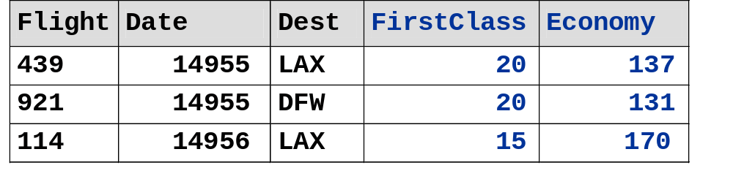
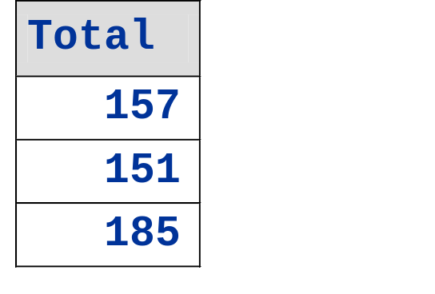
Reading a SAS Data Set
Create a temporary SAS data set named onboard from the permanent SAS data named ia.dfwlax and create a variable that represents the total passengers on board.
Sum FirstClass and Economy values to compute Total.
SAS date values
New Variable
ia.dfwlax

Slide 3
Reading a SAS Data Set
To create a SAS data set using a SAS data set as input, you must use a
  DATA statement to start a DATA step and name the SAS data set being created (output data set: onboard)
  SET statement to identify the SAS data set being read (input data set: ia.dfwlax).
To create a variable, you must use an
  assignment statement to add the values of the variables FirstClass and Economy and assign the sum to the variable Total.

Slide 4
Reading a SAS Data Set
General form of a DATA step:
DATA output-SAS-data-set;
SET input-SAS-data-set;
additional SAS statements
RUN;
By default, the SET statement reads all of the
  observations from the input SAS data set
  variables from the input SAS data set.

Slide 5
Assignment Statements
An assignment statement
  evaluates an expression
  assigns the resulting value to a variable.
General form of an assignment statement:
variable=expression;

Slide 6
SAS Expressions
An expression contains operands and operators that form a set of instructions that produce a value.
Operands are
  variable names
  constants.
Operators are
  symbols that request arithmetic calculations
  SAS functions.

Slide 7
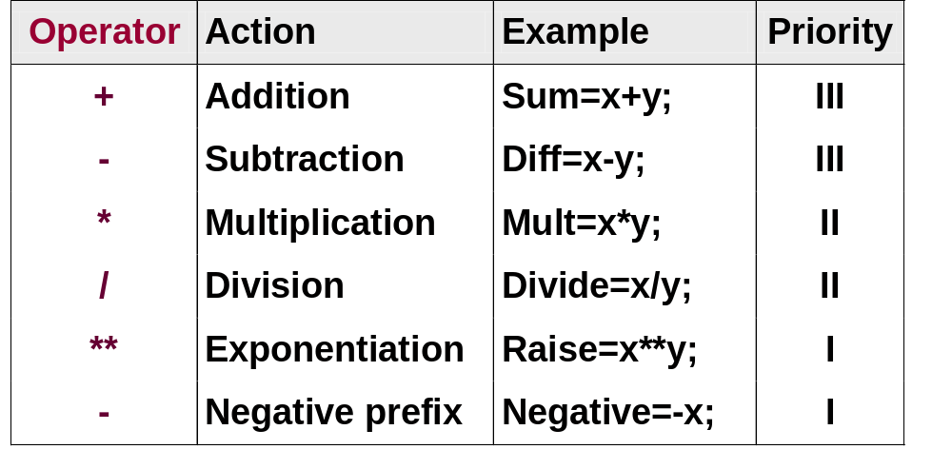
Using Operators
Selected operators for basic arithmetic calculations in an assignment statement:

Slide 8
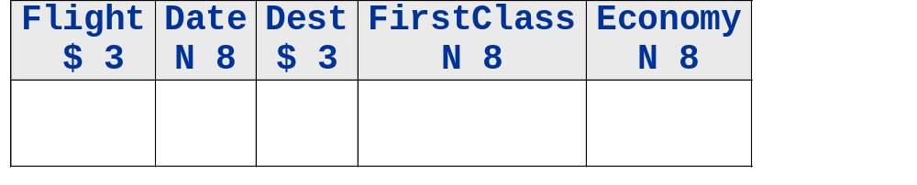
Compiling the DATA Step
libname ia 'SAS-data-library';
data onboard;
set ia.dfwlax;
Total=FirstClass+Economy;
run;
PDV
c07s1d1
...

Slide 9
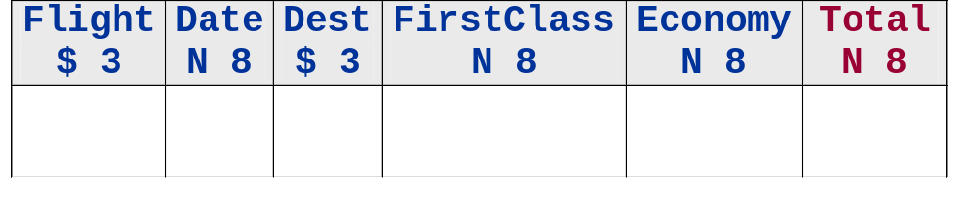
Compiling the DATA Step
libname ia 'SAS-data-library';
data onboard;
set ia.dfwlax;
Total=FirstClass+Economy;
run;
PDV
c07s1d1
...

Slide 10
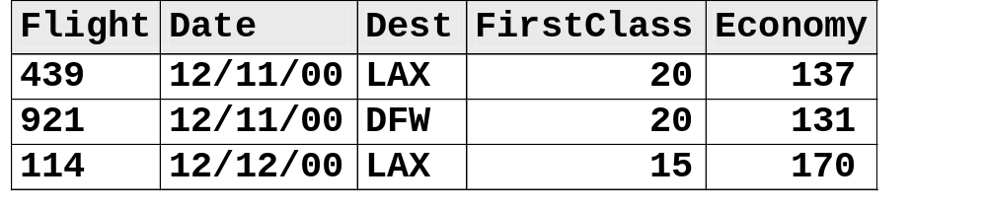
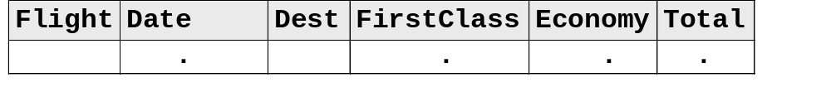

Executing the DATA Step
ia.dfwlax
data onboard;
set ia.dfwlax;
Total=FirstClass+Economy;
run;
PDV
onboard
...

Slide 11
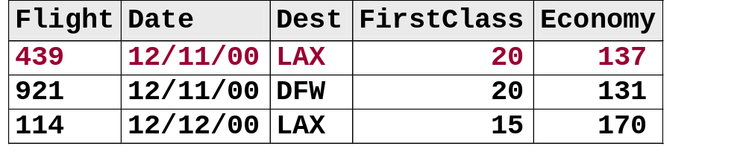
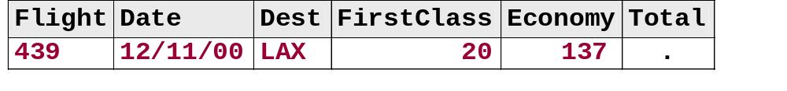
Executing the DATA Step
ia.dfwlax
data onboard;
set ia.dfwlax;
Total=FirstClass+Economy;
run;
PDV
onboard
...

Slide 12
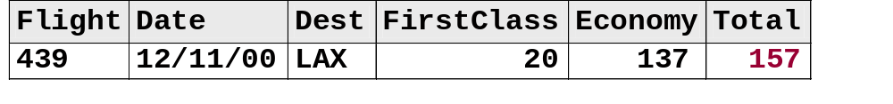
Executing the DATA Step
ia.dfwlax
data onboard;
set ia.dfwlax;
Total=FirstClass+Economy;
run;
PDV
onboard
...

Slide 13
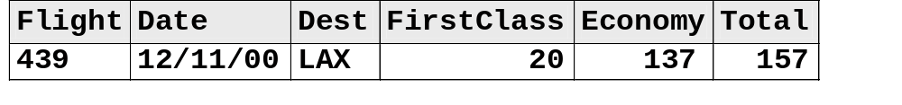
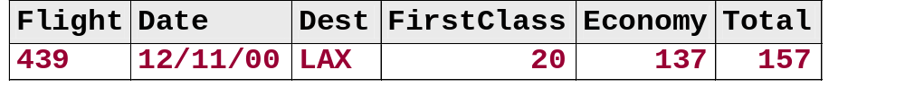
Executing the DATA Step
ia.dfwlax
Automatic return
data onboard;
set ia.dfwlax;
Total=FirstClass+Economy;
run;
PDV
onboard
Automatic output
...

Slide 14
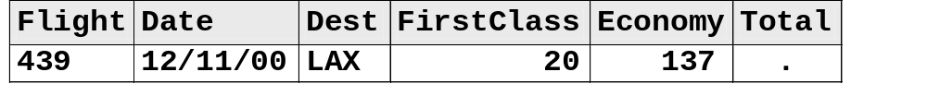

Executing the DATA Step
ia.dfwlax
Reinitialize Total to missing
data onboard;
set ia.dfwlax;
Total=FirstClass+Economy;
run;
PDV
onboard
...

Slide 15
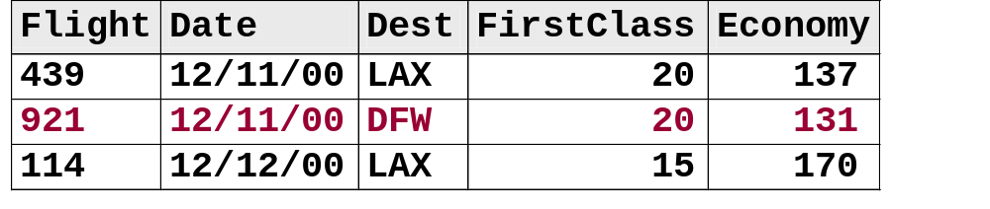
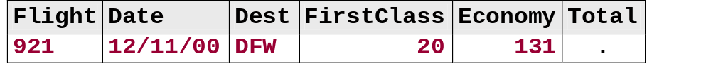

Executing the DATA Step
ia.dfwlax
data onboard;
set ia.dfwlax;
Total=FirstClass+Economy;
run;
PDV
onboard
...

Slide 16
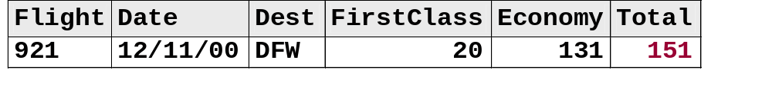
Executing the DATA Step
ia.dfwlax
data onboard;
set ia.dfwlax;
Total=FirstClass+Economy;
run;
PDV
onboard
...

Slide 17
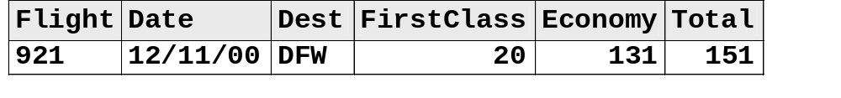
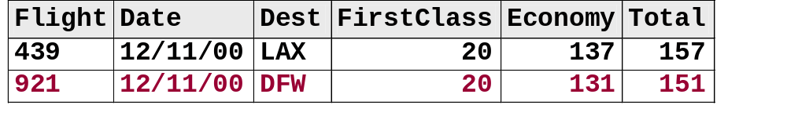
Executing the DATA Step
ia.dfwlax
Automatic return
data onboard;
set ia.dfwlax;
Total=FirstClass+Economy;
run;
PDV
onboard
Automatic output
...

Slide 18

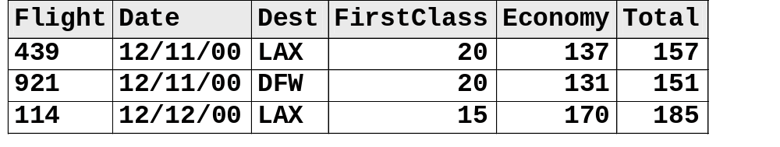
Executing the DATA Step
ia.dfwlax
data onboard;
set ia.dfwlax;
Total=FirstClass+Economy;
run;
PDV
onboard

Slide 19
Assignment Statements
proc print data=onboard;
format Date date9.;
run;
The SAS System
First
Obs Flight Date Dest Class Economy Total
1 439 11DEC2000 LAX 20 137 157
2 921 11DEC2000 DFW 20 131 151
3 114 12DEC2000 LAX 15 170 185
4 982 12DEC2000 dfw 5 85 90
5 439 13DEC2000 LAX 14 196 210
6 982 13DEC2000 DFW 15 116 131
7 431 14DEC2000 LaX 17 166 183
8 982 14DEC2000 DFW 7 88 95
9 114 15DEC2000 LAX . 187 .
10 982 15DEC2000 DFW 14 31 45
Why is Total missing in observation 9?
c07s1d1

Slide 20
Using SAS Functions
A SAS function is a routine that returns a value that is determined from specified arguments.
General form of a SAS function:
function-name(argument1,argument2, . . .)
Example
Total=sum(FirstClass,Economy);

Slide 21
Using SAS Functions
  SAS functions
  perform arithmetic operations
  compute sample statistics (for example: sum, mean, and standard deviation)
  manipulate SAS dates and process character values
  perform many other tasks.
Sample statistics functions ignore missing values.

Slide 22
Using the SUM Function
data onboard;
set ia.dfwlax;
Total=sum(FirstClass,Economy);
run;
c07s1d2

Slide 23
Using the SUM Function
proc print data=onboard;
format Date date9.;
run;
The SAS System
First
Obs Flight Date Dest Class Economy Total
1 439 11DEC2000 LAX 20 137 157
2 921 11DEC2000 DFW 20 131 151
3 114 12DEC2000 LAX 15 170 185
4 982 12DEC2000 dfw 5 85 90
5 439 13DEC2000 LAX 14 196 210
6 982 13DEC2000 DFW 15 116 131
7 431 14DEC2000 LaX 17 166 183
8 982 14DEC2000 DFW 7 88 95
9 114 15DEC2000 LAX . 187 187
10 982 15DEC2000 DFW 14 31 45
c07s1d2

Slide 24
Using Date Functions
You can use SAS date functions to
  create SAS date values
  extract information from SAS date values.

Slide 25
Date Functions: Create SAS Dates
TODAY() obtains the date value from the system clock.
MDY(month,day,year) uses numeric month, day, and year values to return the corresponding SAS date value.

Slide 26
Date Functions: Extracting Information
YEAR(SAS-date) extracts the year from a SAS date and returns a four-digit value for year.
QTR(SAS-date) extracts the quarter from a SAS date and returns a number from 1 to 4.
MONTH(SAS-date) extracts the month from a SAS date and returns a number from 1 to 12.
WEEKDAY(SAS-date) extracts the day of the week from a SAS date and returns a number from 1 to 7, where 1 represents Sunday, and so on.

Slide 27
Using the WEEKDAY Function
Add an assignment statement to the DATA step to create a variable that shows the day of the week that the flight occurred.
data onboard;
set ia.dfwlax;
Total=sum(FirstClass,Economy);
DayOfWeek=weekday(Date);
run;
Print the data set, but do not display the variables FirstClass and Economy.
c07s1d3

Slide 28
Using the WEEKDAY Function
proc print data=onboard;
var Flight Dest Total DayOfWeek Date;
format Date weekdate.;
run;
The SAS System
Day
Of
Obs Flight Dest Total Week Date
1 439 LAX 157 2 Monday, December 11, 2000
2 921 DFW 151 2 Monday, December 11, 2000
3 114 LAX 185 3 Tuesday, December 12, 2000
4 982 dfw 90 3 Tuesday, December 12, 2000
5 439 LAX 210 4 Wednesday, December 13, 2000
6 982 DFW 131 4 Wednesday, December 13, 2000
7 431 LaX 183 5 Thursday, December 14, 2000
8 982 DFW 95 5 Thursday, December 14, 2000
9 114 LAX 187 6 Friday, December 15, 2000
10 982 DFW 45 6 Friday, December 15, 2000
What if you do not want the variables FirstClass and Economy in the data set?
c07s1d3

Slide 29
Selecting Variables
You can use a DROP or KEEP statement in a DATA
step to control what variables are written to the new SAS
data set.
General form of DROP and KEEP statements:
DROP variables;
KEEP variables;

Slide 30
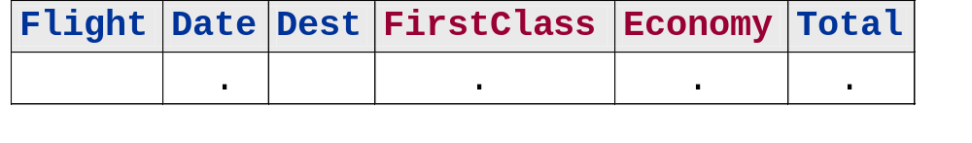
Selecting Variables
Do not store the variables FirstClass and Economy in the data set.
data onboard;
set ia.dfwlax;
drop FirstClass Economy;
Total=FirstClass+Economy;
run;
Equivalent
keep Flight Date Dest Total;
PDV
D
D
c07s1d4

Slide 31
Selecting Variables
proc print data=onboard;
format Date date9.;
run;
The SAS System
Obs Flight Date Dest Total
1 439 11DEC2000 LAX 157
2 921 11DEC2000 DFW 151
3 114 12DEC2000 LAX 185
4 982 12DEC2000 dfw 90
5 439 13DEC2000 LAX 210
6 982 13DEC2000 DFW 131
7 431 14DEC2000 LaX 183
8 982 14DEC2000 DFW 95
9 114 15DEC2000 LAX .
10 982 15DEC2000 DFW 45
c07s1d4

Slide 32

Exercises
These exercises reinforce the concepts discussed previously.

Slide 33
Section 7.2
Conditional Processing

Slide 34
Objectives
  Execute statements conditionally using IF-THEN logic.
  Control the length of character variables explicitly with the LENGTH statement.
  Select rows to include in a SAS data set.
  Use SAS date constants.

Slide 35
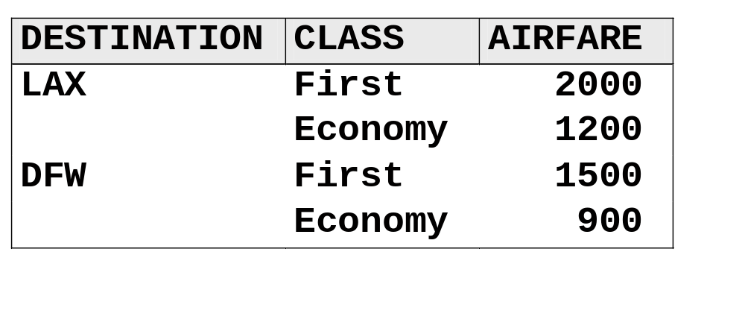
Conditional Execution
International Airlines wants to compute revenue for
Los Angeles and Dallas flights based on the prices in
the table below.

Slide 36
Conditional Execution
General form of IF-THEN and ELSE statements:
IF expression THEN statement;
ELSE statement;
Expression contains operands and operators that form a set of instructions that produce a value.
Operands are
  variable names
  constants.
Operators are
  symbols that request
    a comparison
    a logical operation
    an arithmetic calculation
  SAS functions.
Only one executable statement is allowed on an
IF-THEN or ELSE statement.

Slide 37
Conditional Execution
Compute revenue figures based on flight destination.
data flightrev;
set ia.dfwlax;
Total=sum(FirstClass,Economy);
if Dest='LAX' then
Revenue=sum(2000*FirstClass,1200*Economy);
else if Dest='DFW' then
Revenue=sum(1500*FirstClass,900*Economy);
run;
c07s2d1

Slide 38
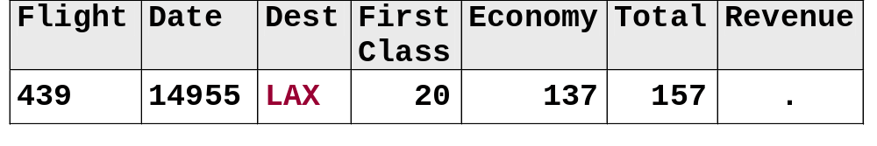
Conditional Execution
TRUE
data flightrev;
set ia.dfwlax;
Total=sum(FirstClass,Economy);
if Dest='LAX' then
Revenue=sum(2000*FirstClass,1200*Economy);
else if Dest='DFW' then
Revenue=sum(1500*FirstClass,900*Economy);
run;
PDV (First Observation)
...

Slide 39
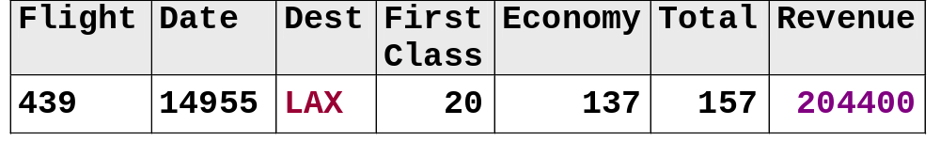
Conditional Execution
TRUE
data flightrev;
set ia.dfwlax;
Total=sum(FirstClass,Economy);
if Dest='LAX' then
Revenue=sum(2000*FirstClass,1200*Economy);
else if Dest='DFW' then
Revenue=sum(1500*FirstClass,900*Economy);
run;
PDV (First Observation)
...

Slide 40
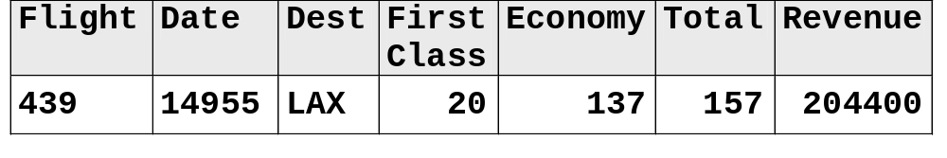
Conditional Execution
data flightrev;
set ia.dfwlax;
Total=sum(FirstClass,Economy);
if Dest='LAX' then
Revenue=sum(2000*FirstClass,1200*Economy);
else if Dest='DFW' then
Revenue=sum(1500*FirstClass,900*Economy);
run;
PDV (First Observation)
...

Slide 41
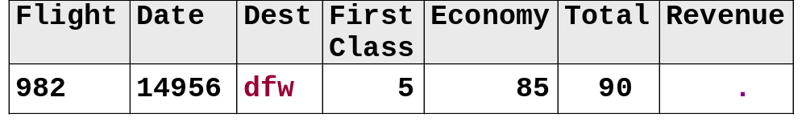
Conditional Execution
FALSE
data flightrev;
set ia.dfwlax;
Total=sum(FirstClass,Economy);
if Dest='LAX' then
Revenue=sum(2000*FirstClass,1200*Economy);
else if Dest='DFW' then
Revenue=sum(1500*FirstClass,900*Economy);
run;
PDV (Fourth Observation)
...

Slide 42
Conditional Execution
FALSE
data flightrev;
set ia.dfwlax;
Total=sum(FirstClass,Economy);
if Dest='LAX' then
Revenue=sum(2000*FirstClass,1200*Economy);
else if Dest='DFW' then
Revenue=sum(1500*FirstClass,900*Economy);
run;
PDV (Fourth Observation)
...

Slide 43
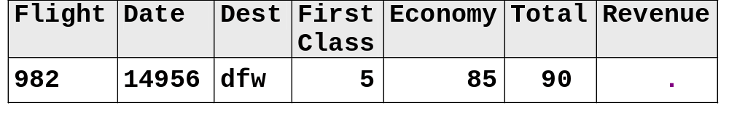
Conditional Execution
data flightrev;
set ia.dfwlax;
Total=sum(FirstClass,Economy);
if Dest='LAX' then
Revenue=sum(2000*FirstClass,1200*Economy);
else if Dest='DFW' then
Revenue=sum(1500*FirstClass,900*Economy);
run;
PDV (Fourth Observation)
...

Slide 44
Conditional Execution
proc print data=flightrev;
format Date date9.;
run;
The SAS System
First
Obs Flight Date Dest Class Economy Total Revenue
1 439 11DEC2000 LAX 20 137 157 204400
2 921 11DEC2000 DFW 20 131 151 147900
3 114 12DEC2000 LAX 15 170 185 234000
4 982 12DEC2000 dfw 5 85 90 .
5 439 13DEC2000 LAX 14 196 210 263200
6 982 13DEC2000 DFW 15 116 131 126900
7 431 14DEC2000 LaX 17 166 183 .
8 982 14DEC2000 DFW 7 88 95 89700
9 114 15DEC2000 LAX . 187 187 224400
10 982 15DEC2000 DFW 14 31 45 48900
Why are two Revenue values missing?
c07s2d1

Slide 45
The UPCASE Function
You can use the UPCASE function to convert letters from lowercase to uppercase.
General form of the UPCASE function:
UPCASE (argument)

Slide 46
Conditional Execution
Use the UPCASE function to convert the Dest values to uppercase for the comparison.
data flightrev;
set ia.dfwlax;
Total=sum(FirstClass,Economy);
if upcase(Dest)='LAX' then
Revenue=sum(2000*FirstClass,1200*Economy);
else if upcase(Dest)='DFW' then
Revenue=sum(1500*FirstClass,900*Economy);
run;
c07s2d2

Slide 47
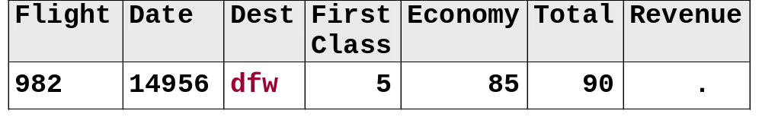
Conditional Execution
FALSE
data flightrev;
set ia.dfwlax;
Total=sum(FirstClass,Economy);
if upcase(Dest)='LAX' then
Revenue=sum(2000*FirstClass,1200*Economy);
else if upcase(Dest)='DFW' then
Revenue=sum(1500*FirstClass,900*Economy);
run;
PDV (Fourth Observation)
upcase('dfw')='DFW'
...

Slide 48
Conditional Execution
TRUE
data flightrev;
set ia.dfwlax;
Total=sum(FirstClass,Economy);
if upcase(Dest)='LAX' then
Revenue=sum(2000*FirstClass,1200*Economy);
else if upcase(Dest)='DFW' then
Revenue=sum(1500*FirstClass,900*Economy);
run;
PDV (Fourth Observation)
upcase('dfw')='DFW'
...

Slide 49
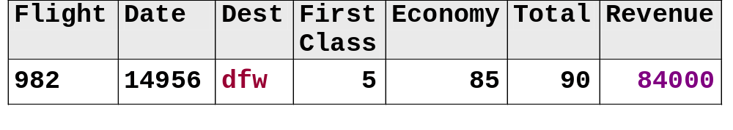
Conditional Execution
TRUE
data flightrev;
set ia.dfwlax;
Total=sum(FirstClass,Economy);
if upcase(Dest)='LAX' then
Revenue=sum(2000*FirstClass,1200*Economy);
else if upcase(Dest)='DFW' then
Revenue=sum(1500*FirstClass,900*Economy);
run;
PDV (Fourth Observation)
upcase('dfw')='DFW'
...

Slide 50
Conditional Execution
proc print data=flightrev;
format Date date9.;
run;
The SAS System
First
Obs Flight Date Dest Class Economy Total Revenue
1 439 11DEC2000 LAX 20 137 157 204400
2 921 11DEC2000 DFW 20 131 151 147900
3 114 12DEC2000 LAX 15 170 185 234000
4 982 12DEC2000 dfw 5 85 90 84000
5 439 13DEC2000 LAX 14 196 210 263200
6 982 13DEC2000 DFW 15 116 131 126900
7 431 14DEC2000 LaX 17 166 183 233200
8 982 14DEC2000 DFW 7 88 95 89700
9 114 15DEC2000 LAX . 187 187 224400
10 982 15DEC2000 DFW 14 31 45 48900
c07s2d2

Slide 51
Conditional Execution
You can use the DO and END statements to execute a group of statements based on a condition.
General form of the DO and END statements:
IF expression THEN DO;
executable statements
END;
ELSE DO;
executable statements
END;

Slide 52
Conditional Execution
Use DO and END statements to execute a group of statements based on a condition.
data flightrev;
set ia.dfwlax;
Total=sum(FirstClass,Economy);
if upcase(Dest)='DFW' then do;
Revenue=sum(1500*FirstClass,900*Economy);
City='Dallas';
end;
else if upcase(Dest)='LAX' then do;
Revenue=sum(2000*FirstClass,1200*Economy);
City='Los Angeles';
end;
run;
c07s2d3

Slide 53
Conditional Execution
proc print data=flightrev;
var Dest City Flight Date Revenue;
format Date date9.;
run;
The SAS System
Obs Dest City Flight Date Revenue
1 LAX Los An 439 11DEC2000 204400
2 DFW Dallas 921 11DEC2000 147900
3 LAX Los An 114 12DEC2000 234000
4 dfw Dallas 982 12DEC2000 84000
5 LAX Los An 439 13DEC2000 263200
6 DFW Dallas 982 13DEC2000 126900
7 LaX Los An 431 14DEC2000 233200
8 DFW Dallas 982 14DEC2000 89700
9 LAX Los An 114 15DEC2000 224400
10 DFW Dallas 982 15DEC2000 48900
Why are City values truncated?
c07s2d3

Slide 54
Variable Lengths
At compile time, the length of a variable is determined the first time the variable is encountered.
data flightrev;
set ia.dfwlax;
Total=sum(FirstClass,Economy);
if upcase(Dest)='DFW' then do;
Revenue=sum(1500*FirstClass,900*Economy);
City='Dallas';
end;
else if upcase(Dest)='LAX' then do;
Revenue=sum(2000*FirstClass,1200*Economy);
City='Los Angeles';
end;
run;
6 characters between the quotes: Length=6
...

Slide 55
The LENGTH Statement
You can use the LENGTH statement to define the length of a variable explicitly.
General form of the LENGTH statement:
Example:
LENGTH variable(s) $ length;
length City $ 11;

Slide 56
The LENGTH Statement
data flightrev;
set ia.dfwlax;
length City $ 11;
Total=sum(FirstClass,Economy);
if upcase(Dest)='DFW' then do;
Revenue=sum(1500*FirstClass,900*Economy);
City='Dallas';
end;
else if upcase(Dest)='LAX' then do;
Revenue=sum(2000*FirstClass,1200*Economy);
City='Los Angeles';
end;
run;
c07s2d4

Slide 57
The LENGTH Statement
proc print data=flightrev;
var Dest City Flight Date Revenue;
format Date date9.;
run;
The SAS System
Obs Dest City Flight Date Revenue
1 LAX Los Angeles 439 11DEC2000 204400
2 DFW Dallas 921 11DEC2000 147900
3 LAX Los Angeles 114 12DEC2000 234000
4 dfw Dallas 982 12DEC2000 84000
5 LAX Los Angeles 439 13DEC2000 263200
6 DFW Dallas 982 13DEC2000 126900
7 LaX Los Angeles 431 14DEC2000 233200
8 DFW Dallas 982 14DEC2000 89700
9 LAX Los Angeles 114 15DEC2000 224400
10 DFW Dallas 982 15DEC2000 48900
c07s2d4

Slide 58
Subsetting Rows
In a DATA step, you can subset the rows (observations) in a SAS data set with a
  WHERE statement
  DELETE statement
  subsetting IF statement.
The WHERE statement in a DATA step is the same as the WHERE statement you saw in a PROC step.

Slide 59
Deleting Rows
You can use a DELETE statement to control which rows are written to the SAS data set.
General form of the DELETE statement:
The expression can be any SAS expression.
IF expression THEN DELETE;

Slide 60
Deleting Rows
Delete rows that have a Total value that is less than or equal to 175.
data over175;
set ia.dfwlax;
length City $ 11;
Total=sum(FirstClass,Economy);
if Total le 175 then delete;
if upcase(Dest)='DFW' then do;
Revenue=sum(1500*FirstClass,900*Economy);
City='Dallas';
end;
else if upcase(Dest)='LAX' then do;
Revenue=sum(2000*FirstClass,1200*Economy);
City='Los Angeles';
end;
run;
c07s2d5

Slide 61
Deleting Rows
proc print data=over175;
var Dest City Flight Date Total Revenue;
format Date date9.;
run;
The SAS System
Obs Dest City Flight Date Total Revenue
1 LAX Los Angeles 114 12DEC2000 185 234000
2 LAX Los Angeles 439 13DEC2000 210 263200
3 LaX Los Angeles 431 14DEC2000 183 233200
4 LAX Los Angeles 114 15DEC2000 187 224400
c07s2d5

Slide 62
Selecting Rows
You can use a subsetting IF statement to control which rows are written to the SAS data set.
General form of the subsetting IF statement:
The expression can be any SAS expression.
The subsetting IF statement is valid only in a DATA step.
IF expression;

Slide 63
Process Flow of a Subsetting IF
DATA Statement
Subsetting IF:
Read Observation
or Record
IF expression
False
True
Continue Processing Observation
Output Observation to SAS Data Set

Slide 64
Process Flow of a Subsetting IF
DATA Statement
Subsetting IF:
Read Observation
or Record
False
IF expression
False
True
Continue Processing Observation
Output Observation to SAS Data Set
...

Slide 65
Selecting Rows
Select rows that have a Total value that is greater than 175.
data over175;
set ia.dfwlax;
length City $ 11;
Total=sum(FirstClass,Economy);
if Total gt 175;
if upcase(Dest)='DFW' then do;
Revenue=sum(1500*FirstClass,900*Economy);
City='Dallas';
end;
else if upcase(Dest)='LAX' then do;
Revenue=sum(2000*FirstClass,1200*Economy);
City='Los Angeles';
end;
run;
c07s2d6

Slide 66
Selecting Rows
proc print data=over175;
var Dest City Flight Date Total Revenue;
format Date date9.;
run;
The SAS System
Obs Dest City Flight Date Total Revenue
1 LAX Los Angeles 114 12DEC2000 185 234000
2 LAX Los Angeles 439 13DEC2000 210 263200
3 LaX Los Angeles 431 14DEC2000 183 233200
4 LAX Los Angeles 114 15DEC2000 187 224400
c07s2d6

Slide 67
Selecting Rows
The variable Date in the ia.dfwlax data set contains SAS date values (numeric values).
01JAN1960
01JAN1961
14DEC2000
store
0
366
???
display
01/01/1959
01/01/1960
12/14/2000
What if you only wanted flights that were before a specific date, such as 14DEC2000?

Slide 68
Using SAS Date Constants
The constant 'ddMMMyyyy'd (example: '14dec2000'd) creates a SAS date value from the date enclosed in quotes.
dd is a one- or two-digit value for the day.
  MMM is a three-letter abbreviation for the month (JAN, FEB, MAR, and so on).
  yyyy is a two- or four-digit value for the year.
  d is required to convert the quoted string to a SAS date.

Slide 69
Using SAS Date Constants
data over175;
set ia.dfwlax;
length City $ 11;
Total=sum(FirstClass,Economy);
if Total gt 175 and Date lt '14dec2000'd;
if upcase(Dest)='DFW' then do;
Revenue=sum(1500*FirstClass,900*Economy);
City='Dallas';
end;
else if upcase(Dest)='LAX' then do;
Revenue=sum(2000*FirstClass,1200*Economy);
City='Los Angeles';
end;
run;
c07s2d7

Slide 70
Using SAS Date Constants
proc print data=over175;
var Dest City Flight Date Total Revenue;
format Date date9.;
run;
The SAS System
Obs Dest City Flight Date Total Revenue
1 LAX Los Angeles 114 12DEC2000 185 234000
2 LAX Los Angeles 439 13DEC2000 210 263200
c07s2d7

Slide 71
Subsetting Data
What if the data were in a raw data file instead of a
SAS data set?
data over175;
infile 'raw-data-file';
input @1 Flight $3. @4 Date mmddyy8.
@12 Dest $3. @15 FirstClass 3.
@18 Economy 3.;
length City $ 11;
Total=sum(FirstClass,Economy);
if Total gt 175 and Date lt '14dec2000'd;
if upcase(Dest)='DFW' then do;
Revenue=sum(1500*FirstClass,900*Economy);
City='Dallas';
end;
else if upcase(Dest)='LAX' then do;
Revenue=sum(2000*FirstClass,1200*Economy);
City='Los Angeles';
end;
run;
c07s2d8

Slide 72
Subsetting Data
proc print data=over175;
var Dest City Flight Date Total Revenue;
format Date date9.;
run;
The SAS System
Obs Dest City Flight Date Total Revenue
1 LAX Los Angeles 114 12DEC2000 185 234000
2 LAX Los Angeles 439 13DEC2000 210 263200
c07s2d8

Slide 73
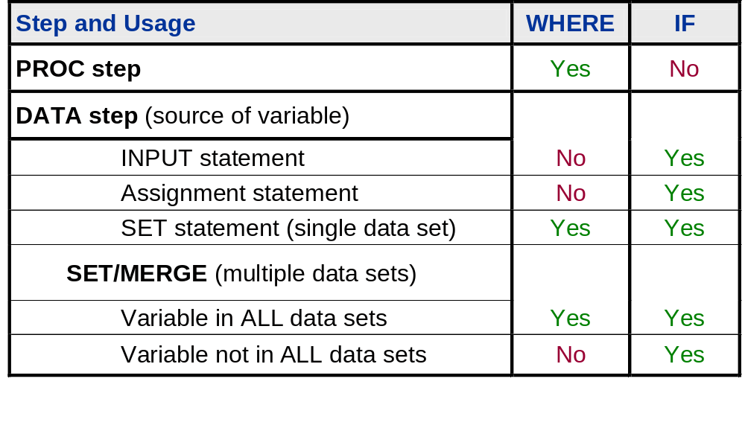
WHERE or Subsetting IF?

Slide 74
WHERE or Subsetting IF?
Use a WHERE statement and a subsetting IF statement in the same step.
data over175;
set ia.dfwlax;
where Date lt '14dec2000'd;
length City $ 11;
Total=sum(FirstClass,Economy);
if Total gt 175;
if upcase(Dest)='DFW' then do;
Revenue=sum(1500*FirstClass,900*Economy);
City='Dallas';
end;
else if upcase(Dest)='LAX' then do;
Revenue=sum(2000*FirstClass,1200*Economy);
City='Los Angeles';
end;
run;
c07s2d9

Slide 75
WHERE or Subsetting IF?
proc print data=over175;
var Dest City Flight Date Total Revenue;
format Date date9.;
run;
The SAS System
Obs Dest City Flight Date Total Revenue
1 LAX Los Angeles 114 12DEC2000 185 234000
2 LAX Los Angeles 439 13DEC2000 210 263200
c07s2d9

Slide 76
Exercises
These exercises reinforce the concepts discussed previously.

Slide 77
Section 7.3
Dropping and Keeping Variables (Self-Study)

Slide 78
Objectives
  Compare DROP and KEEP statements to DROP= and KEEP= data set options.

Slide 79
Selecting Variables
You can use a DROP= or KEEP= data set option in a DATA statement to control what variables are written to the new SAS data set.
General form of the DROP= and KEEP= data set options:
SAS-data-set(DROP=variables)
or
SAS-data-set(KEEP=variables)

Slide 80
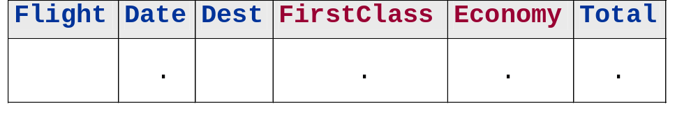
Selecting Variables
Do not store the variables FirstClass and Economy in the data set.
data onboard(drop=FirstClass Economy);
set ia.dfwlax;
Total=FirstClass+Economy;
run;
Equivalent
data onboard(keep=Flight Date Dest Total);
PDV
D
D
c07s3d1
...

Slide 81
Selecting Variables
proc print data=onboard;
format Date date9.;
run;
The SAS System
Obs Flight Date Dest Total
1 439 11DEC2000 LAX 157
2 921 11DEC2000 DFW 151
3 114 12DEC2000 LAX 185
4 982 12DEC2000 dfw 90
5 439 13DEC2000 LAX 210
6 982 13DEC2000 DFW 131
7 431 14DEC2000 LaX 183
8 982 14DEC2000 DFW 95
9 114 15DEC2000 LAX .
10 982 15DEC2000 DFW 45
c07s3d1

Slide 82
Selecting Variables
DROP= and KEEP= data set options in a DATA statement
are similar to DROP and KEEP statements.
data onboard(drop=FirstClass Economy);
set ia.dfwlax;
Total=FirstClass+Economy;
run;
Equivalent
data onboard(keep=Flight Date Dest Total);
Equivalent Steps
data onboard;
drop FirstClass Economy;
set ia.dfwlax;
Total=FirstClass+Economy;
run;
Equivalent
keep Flight Date Dest Total;
c07s3d2

Slide 83
Exercises
These exercises reinforce the concepts discussed previously.

Slide 84
Section 7.4
Reading Excel Spreadsheets Containing Date Fields (Self-Study)

Slide 85
Objectives
  Create a SAS data set from an Excel spreadsheet that contains date fields.
  Create a SAS data set from an Excel spreadsheet that contains datetime fields.

Slide 86
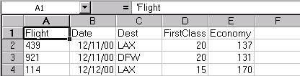
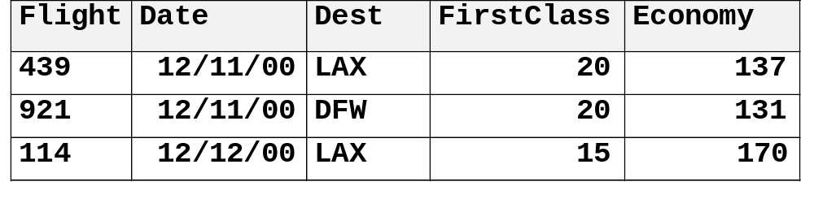
Business Task
The flight data for Dallas and Los Angeles are in an Excel spreadsheet. The departure date is stored as a date field in the spreadsheet.
Excel Spreadsheet
Excel Spreadsheet
SAS Data Set
SAS Data Set

Slide 87
Importing Date Fields
Use the IMPORT procedure to create a SAS data set from the spreadsheet containing date fields.
proc import out=work.dfwlaxdates
datafile='datefields.xls'
dbms=excel2000 replace;
run;
proc print data=work.dfwlaxdates;
run;
c07s4d1

Slide 88
Importing Date Fields
PROC IMPORT automatically converts the spreadsheet date fields to SAS date values and assigns the DATE9. format.
The SAS System
First
Obs Flight Date Dest Class Economy
1 439 11DEC2000 LAX 20 137
2 921 11DEC2000 DFW 20 131
3 114 12DEC2000 LAX 15 170
4 982 12DEC2000 dfw 5 85
5 439 13DEC2000 LAX 14 196
6 982 13DEC2000 DFW 15 116
7 431 14DEC2000 LaX 17 166
8 982 14DEC2000 DFW 7 88
9 114 15DEC2000 LAX . 187
10 982 15DEC2000 DFW 14 31

Slide 89
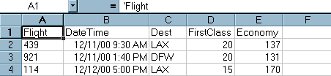
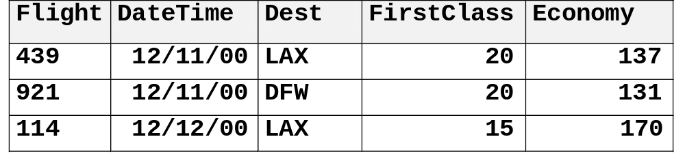
Importing Date-Time Fields
PROC IMPORT also converts spreadsheet fields that contain date-time information into SAS date values and assigns the DATE9. format.
Excel Spreadsheet
Excel Spreadsheet
SAS Data Set

Slide 90
Importing Date-Time Fields
To import datetime fields as SAS datetime values, add the USEDATE=NO statement to the PROC IMPORT step.
proc import out=work.dfwlaxdatetimes
datafile='datetimefields.xls'
dbms=excel2000 replace;
usedate=no;
run;
proc print data=work.dfwlaxdatetimes;
run;
c07s4d2

Slide 91
SAS Datetime Values
A SAS datetime value is interpreted as the number of seconds between midnight, January 1, 1960, and a specific date and time.
31DEC1959:23:00:00
01JAN1960:01:00:00
01JAN1960:00:00:00
31DEC1959:23:59:00
01JAN1960:00:01:00
informat
-3600
-60
0
60
3600
format
01JAN1960:00:00:00

Slide 92
Importing Date-Time Fields
The DATETIME19. format is assigned to the SAS datetime values.
The SAS System
First
Obs Flight DateTime Dest Class Economy
1 439 11DEC2000:09:30:00 LAX 20 137
2 921 11DEC2000:13:40:00 DFW 20 131
3 114 12DEC2000:17:00:00 LAX 15 170
4 982 12DEC2000:18:10:00 dfw 5 85
5 439 13DEC2000:09:30:00 LAX 14 196
6 982 13DEC2000:18:10:00 DFW 15 116
7 431 14DEC2000:13:00:00 LaX 17 166
8 982 14DEC2000:18:10:00 DFW 7 88
9 114 15DEC2000:17:00:00 LAX . 187
10 982 15DEC2000:18:10:00 DFW 14 31

Slide 93
The DATEPART Function
You can use the DATEPART function to extract the date portion of a SAS datetime value.
DATEPART(SASdatetime) returns the SAS date value
from a SAS datetime value.
SAS datetime value (stored in seconds)
Formatted SAS datetime value
1291281300
01DEC2000:09:15:00
datepart(SASdatetimevalue)
SAS date value (stored in days)
Formatted SAS date value
14945
01DEC2000

Slide 94
Exercises
These exercises reinforce the concepts discussed previously.

